Slide 1
Python Tuples
DVT101 – Lecture 25
- By Dataverse Tutorials

Slide 2
Introduction to Tuples
What is a tuple in Python?
Ordered, immutable collection
Similar to lists but cannot be modified
Used for fixed data sets

Slide 3
Why Tuples?
Data safety with immutability
Faster than lists for read-only data
Ideal for constant configurations
Suitable for function returns & records

Slide 4
Key Characteristics of Tuples
Ordered sequence
Immutable (cannot change)
Heterogeneous data types
Can store nested structures

Slide 5
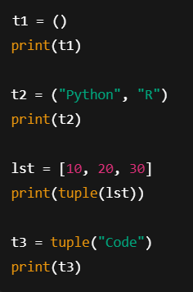
Creating Tuples
Empty tuple
Using parentheses
From list using tuple()
From string using tuple()

Slide 6
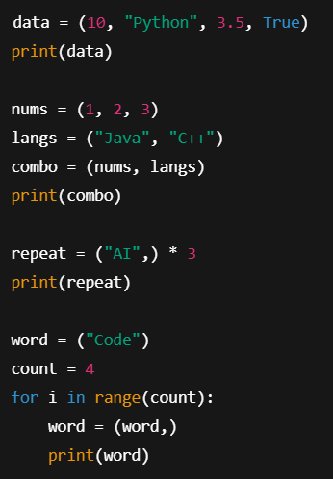
Tuples with Mixed & Nested Data
Mixed data types
Nested tuples
Tuple repetition using *
Tuple creation using loops

Slide 7
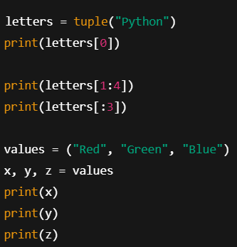
Accessing Tuple Elements
Positive indexing
Negative indexing
Range slicing
Out-of-range behavior

Slide 8
Tuple Unpacking
Assign tuple values to variables
One-to-one unpacking
Meaningful variable assignment

Slide 9
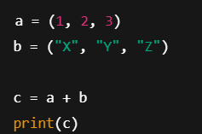
Tuple Concatenation
Combining two tuples using +
Creates a new tuple
Type compatibility rule

Slide 10
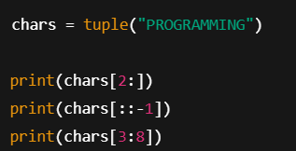
Tuple Slicing
Extracting sub-tuples
Reverse using step -1
Partial ranges

Slide 11
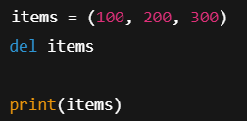
Deleting a Tuple
Tuples are immutable
Cannot delete individual elements
del keyword deletes full tuple
NameError after deletion

Slide 12
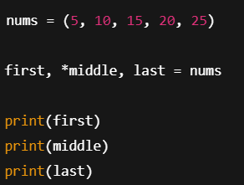
Tuple Unpacking with Asterisk (*)
Collect multiple values
Flexible variable assignment
Middle value capture

Slide 13
Real-World & Industry Use Cases
Configuration constants
Database row representation
Function multiple returns
Coordinate systems
Immutable records

Slide 14
Summary & Key Takeaways
Tuples are immutable lists
Safe, fast, and memory efficient
Support slicing, unpacking, nesting
Best for fixed and read-only data

Slide 15


